Slide 1

VIRTUAL STUDY ROOM
WITH FOCUS TIMERS
IDEA: Create a virtual space where users can collaborate ,set focus timers and share study resources
THEME: SMART EDUCATION
CATEGORY: Software
TEAM MEMBERS:
M.Narendar VTU28192
R.Siva VTU28286
R.Samuel ignatius VTU28145

Slide 2






INTRODUCTION:
Students struggle with distractions, loneliness and poor time management while studying online.remote study often lacks accountability ,so our idea is to create a supportive in-person study atmosphere with scheduled focus sessions,resource libraries plus time tracking analytics and reminders
To emphasize user journey we have added the option to join and create rooms, can set goals and timers for the study session
Students can view their weekly highlights and study streaks ,which motivates the user to stay consistent

Slide 3




TECHNICAL APPROACH
FOR OUR APPLICATION WE HAVE USED THE PROGRAMMING LANGUAGES SUCH AS
CSS3: For styling,responsive layout,animations and themes
JAVA SCRIPT: For interactivity,dynamic content updates,form validations and personalized recommendations
LOCAL JSON DATA: To store career options
obstacles and suggestions for dynamic
rendering

Slide 4
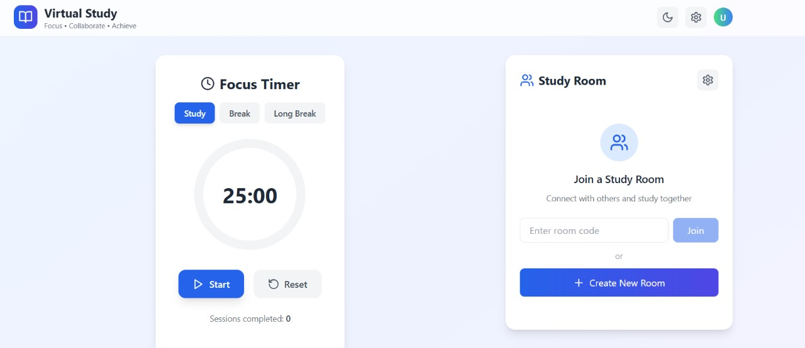
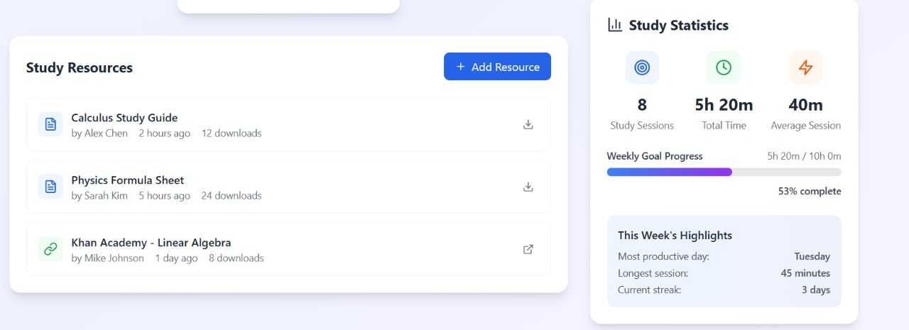
VIRTUAL STUDY

Slide 5



FEASIBILITY AND VIABILITY
The cost is low at the start, and the benefits are high — students focus more, learn together, and can access it from anywhere
Free tier: basic rooms, timers, resource upload
Technical Feasibility: The solution uses only HTML, CSS,NODE.JS and JS
Usability & Accessibility: It's designed to be easy for students to operate without guidance, with content updates via JSON/JS arrays, and is responsive across various devices.
Practical Value: The solution offers personalized career guidance and course recommendations.
Scalable architecture
The system can start small (few users on one server) and easily scale to thousands of students by adding more servers or moving to cloud services.

Slide 6
IMAPACTS AND BENEFITS
Social accountability boosts study time (body-doubling / virtual coworking).
Time management features (timers, break reminders) reduce procrastination.
Resource sharing and group sessions create peer-learning benefits.
Students gain organizational skills by managing digital checklists and time more effectively, with instant resource sharing, lesson recording, and self-paced learning opportunities
Collaboration tools facilitate real-time interaction, peer support, and group work, fostering a sense of community and belonging among participants

Slide 7
RESEARCH AND REFERENCE
Pomodoro / Pomofocus / Pomodor reviews & roundup. Discord / Study With Me communities — community critiques & studies. GoConqr — study resources & collaborative learning.
BestColleges. (2021). 2021 Online Education Trends Report. Chegg.org. (2021). Global Student Survey. Cirillo, F. (n.d.). The Pomodoro Technique. Francesco Cirillo. Retrieved from francescocirillo.com/pages/pomodoro-techniqueOphir, E., Nass, C., & Wagner, A. D. (2009). Cognitive control in media multitaskers. Proceedings of the National Academy of Sciences, 106(37), 15583-15587.Grand View Research. (2023). Team Collaboration Software Market Size, Share & Trends Analysis Report. Report ID: GVR-1-68038-796-0.

